Slide 1


Combination Lock Workshop
Hive Makerspace Workshop Fall 2024
Elias Black

Slide 2

What are Locks?

Slide 3
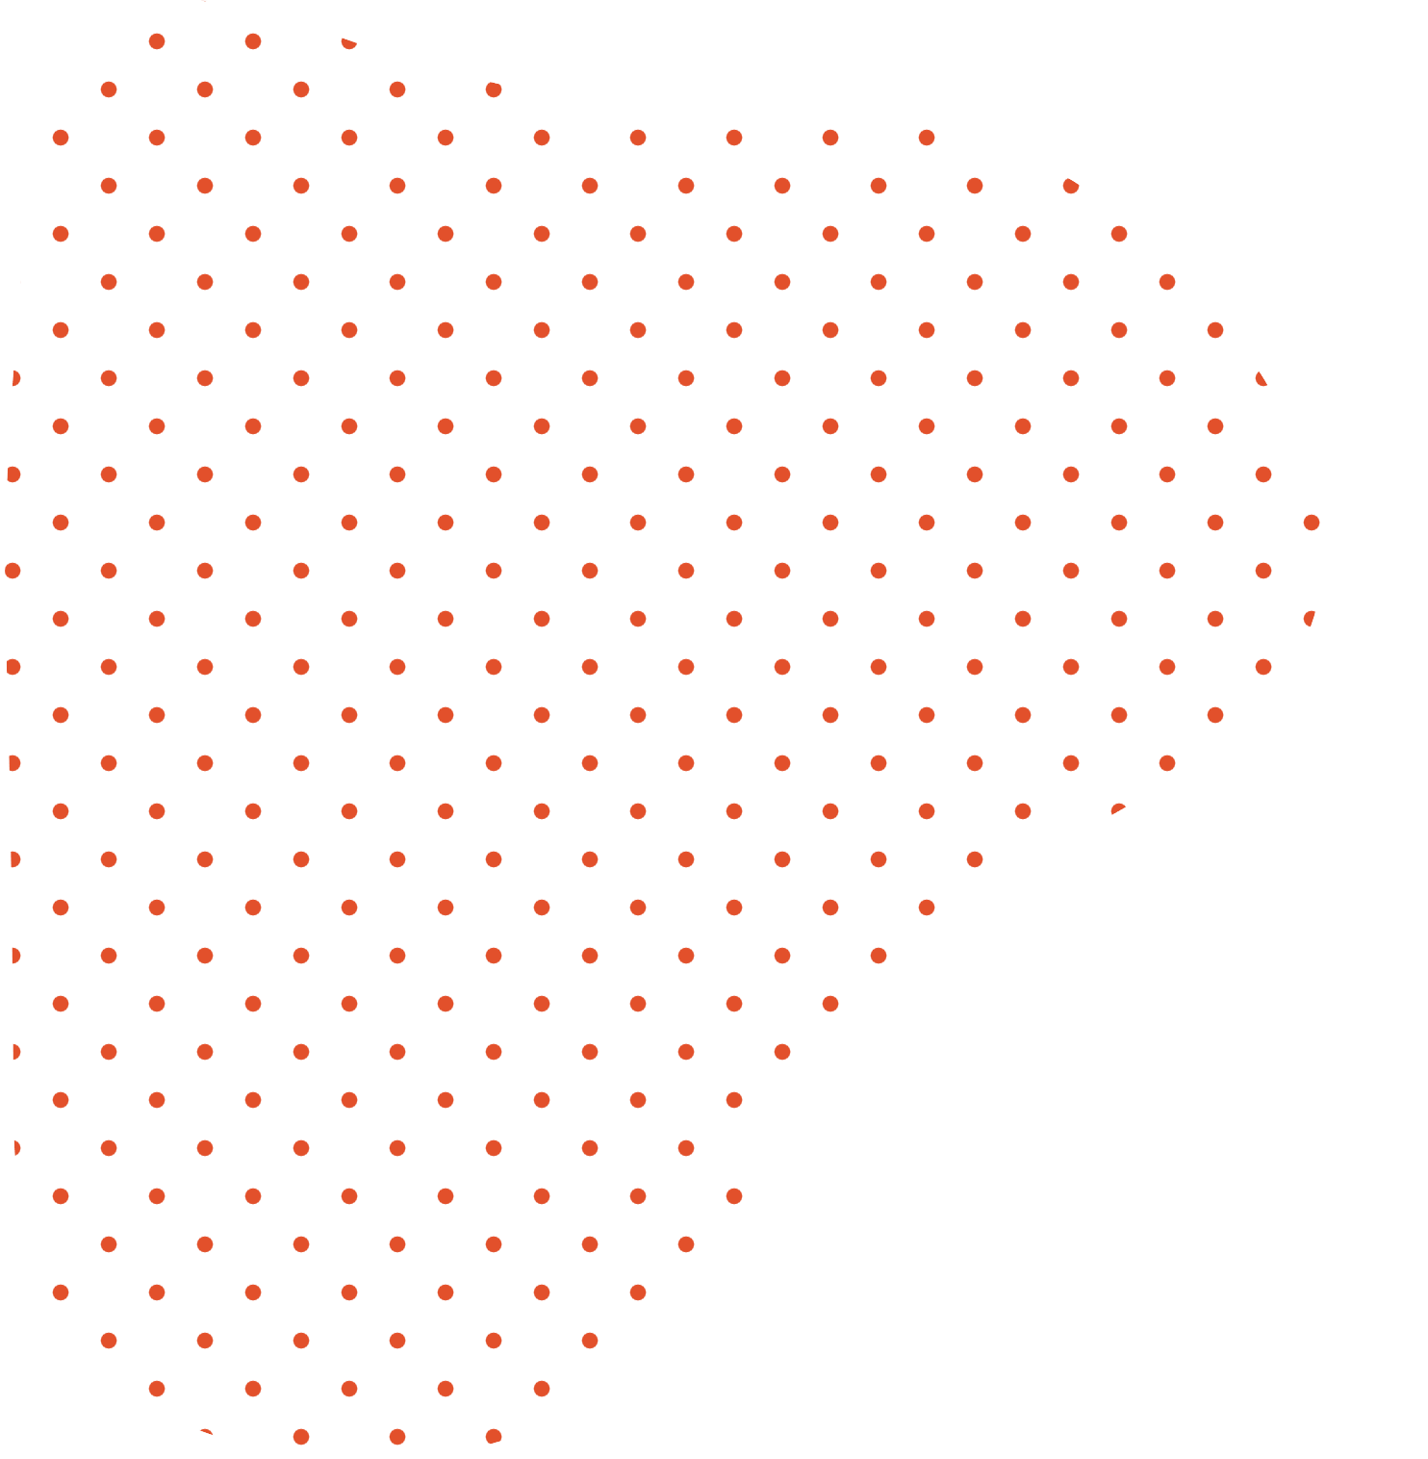
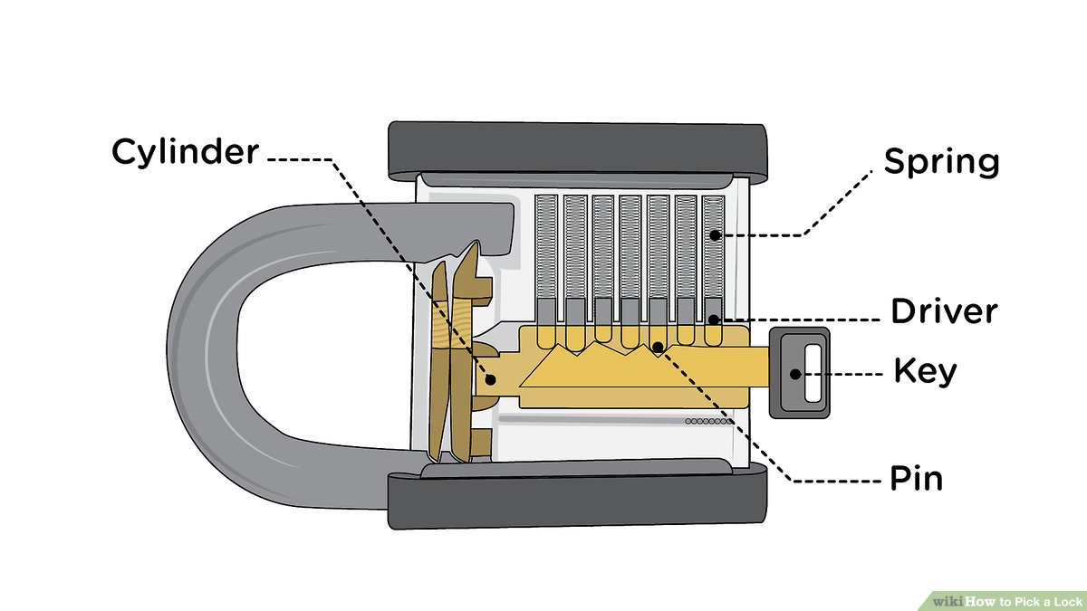
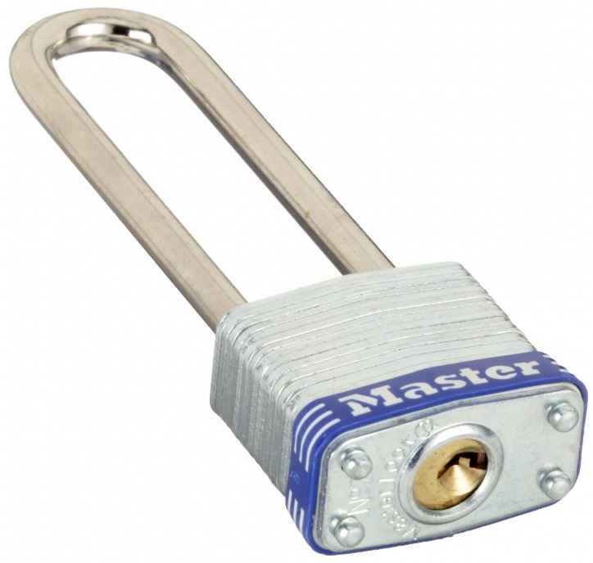
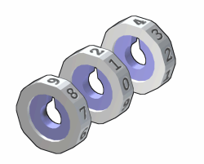
Parts and Pieces of Locks
Shackle
Padlock tumblers
Release Mechanism
Notes:
Image credit: https://bambulab.com/en/p1

Slide 4
Different Types of Locks

Slide 5
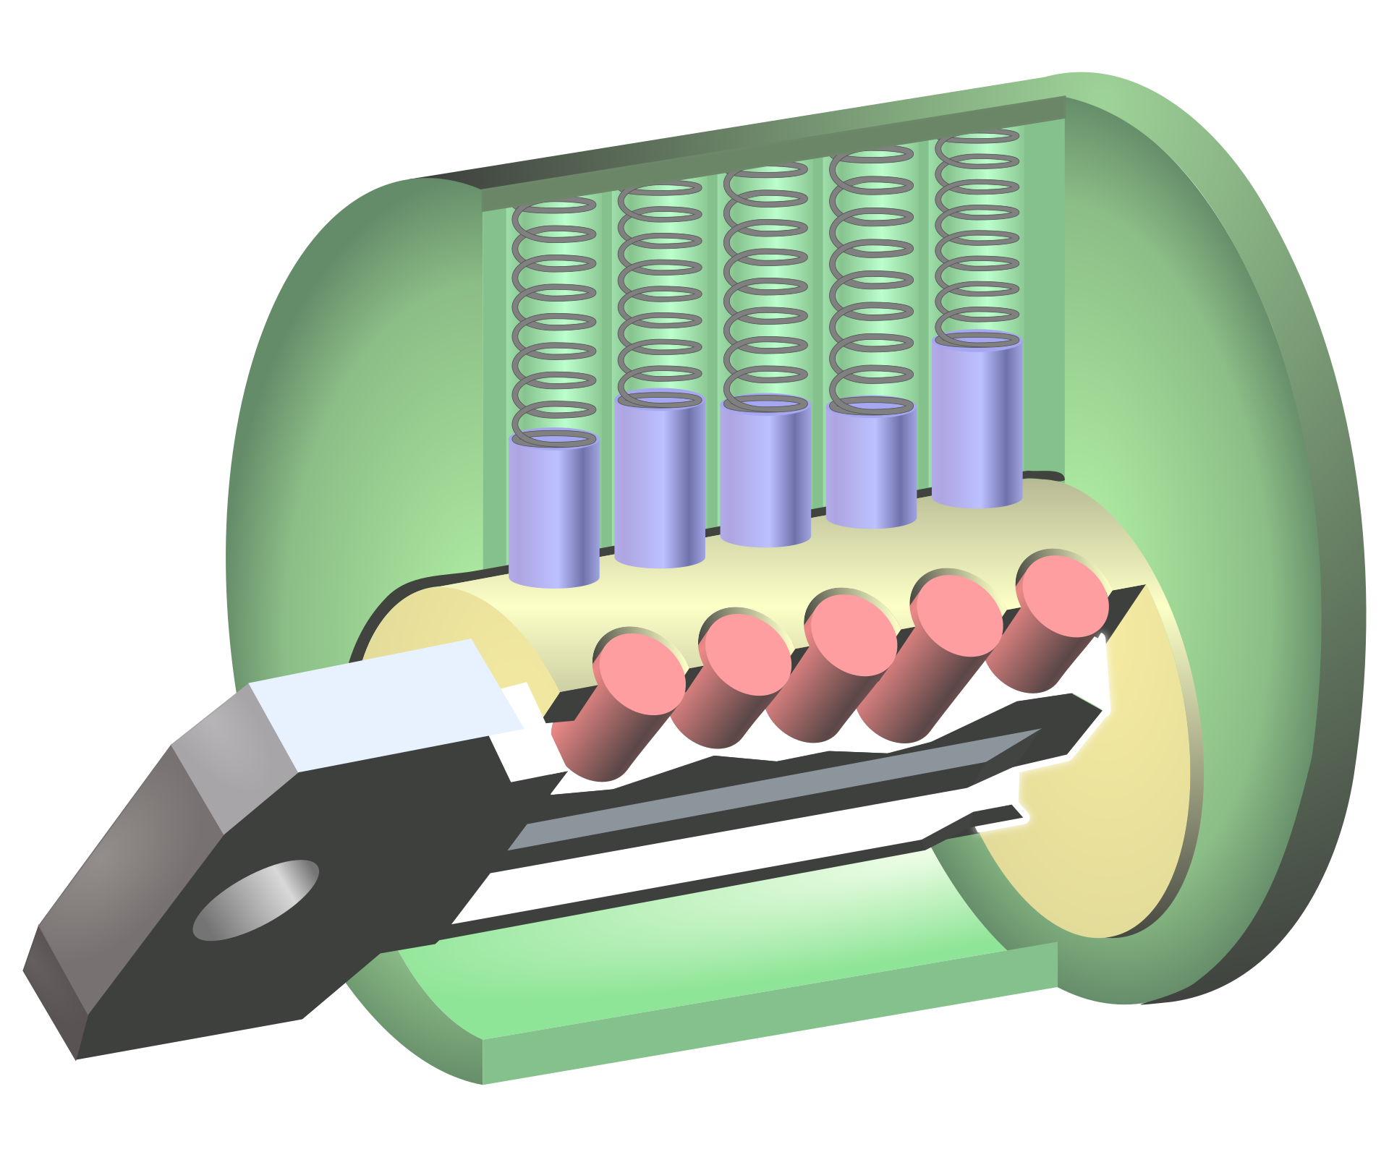
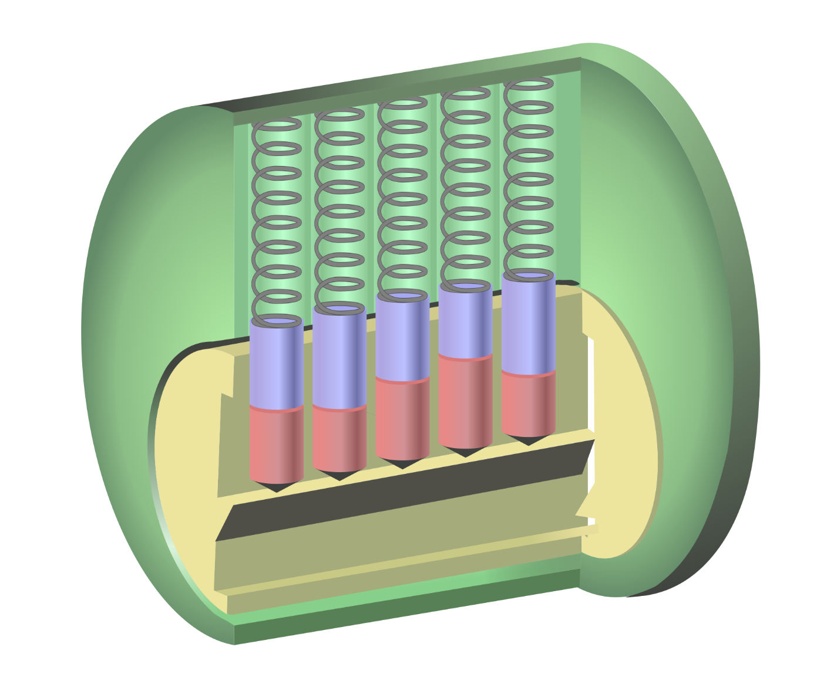
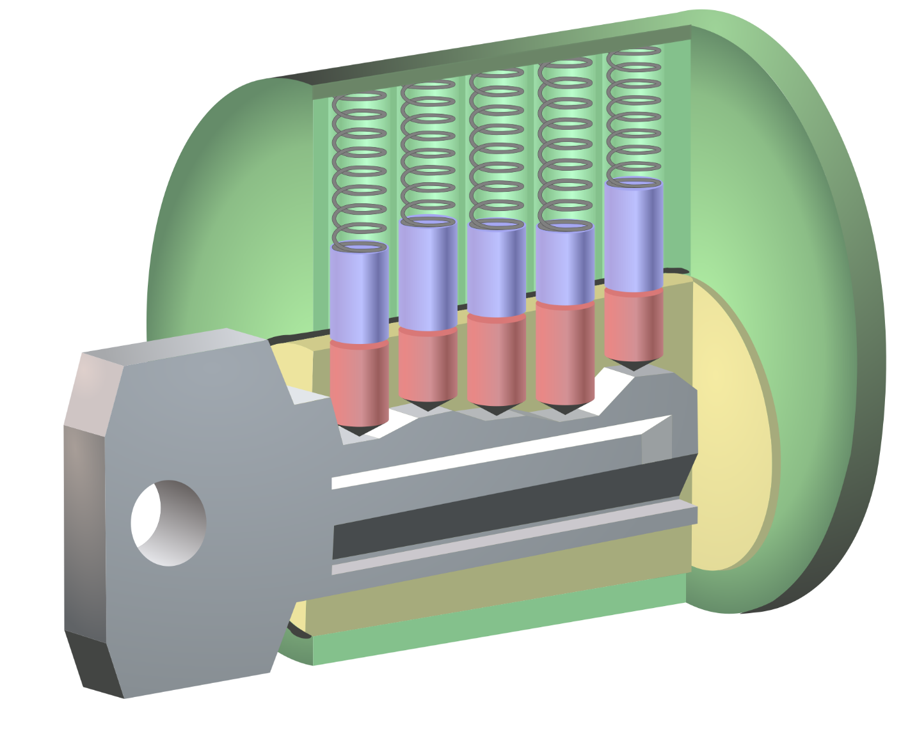
Pin Tumbler Lock
Notes:
Image credit: https://en.wikipedia.org/wiki/Pin_tumbler_lock#Cylinder_locks

Slide 6

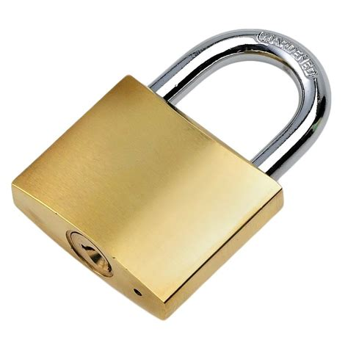
Pin Tumbler Lock
Common Uses:
Notes:
Image credit: https://www.hgtv.com/design/topics/doors
Image credit: https://www.storagegiant.co.uk/product/50mm-padlock/

Slide 7
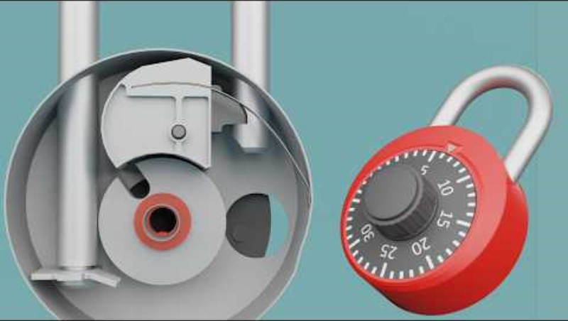
Combination Locks

Slide 8
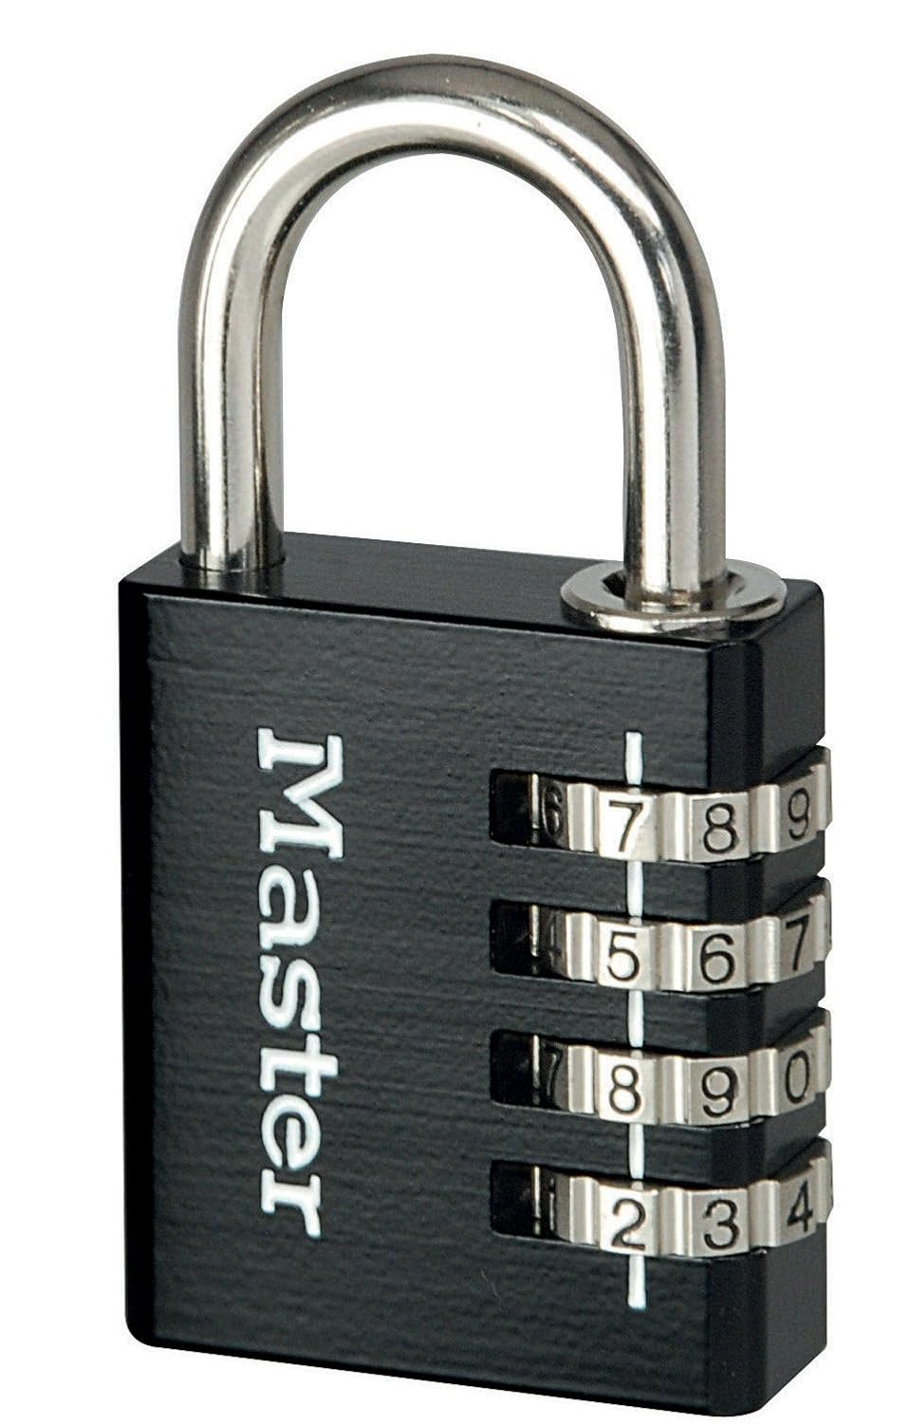
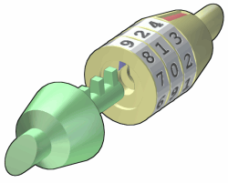
Combination Padlocks
Notes:
Image credit: https://www.ebay.co.uk/p/1323993627?iid=201657858648
Image credit: https://en.wikipedia.org/wiki/Combination_lock

Slide 9
When do Locks not work?

Slide 10
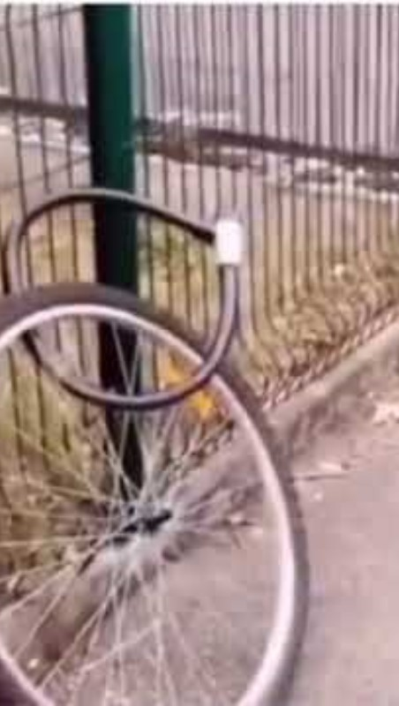
Notes:
Image credit: https://en.wikipedia.org/wiki/Pin_tumbler_lock#Cylinder_locks Image credit: https://en.wikipedia.org/wiki/Lock_picking

Slide 11
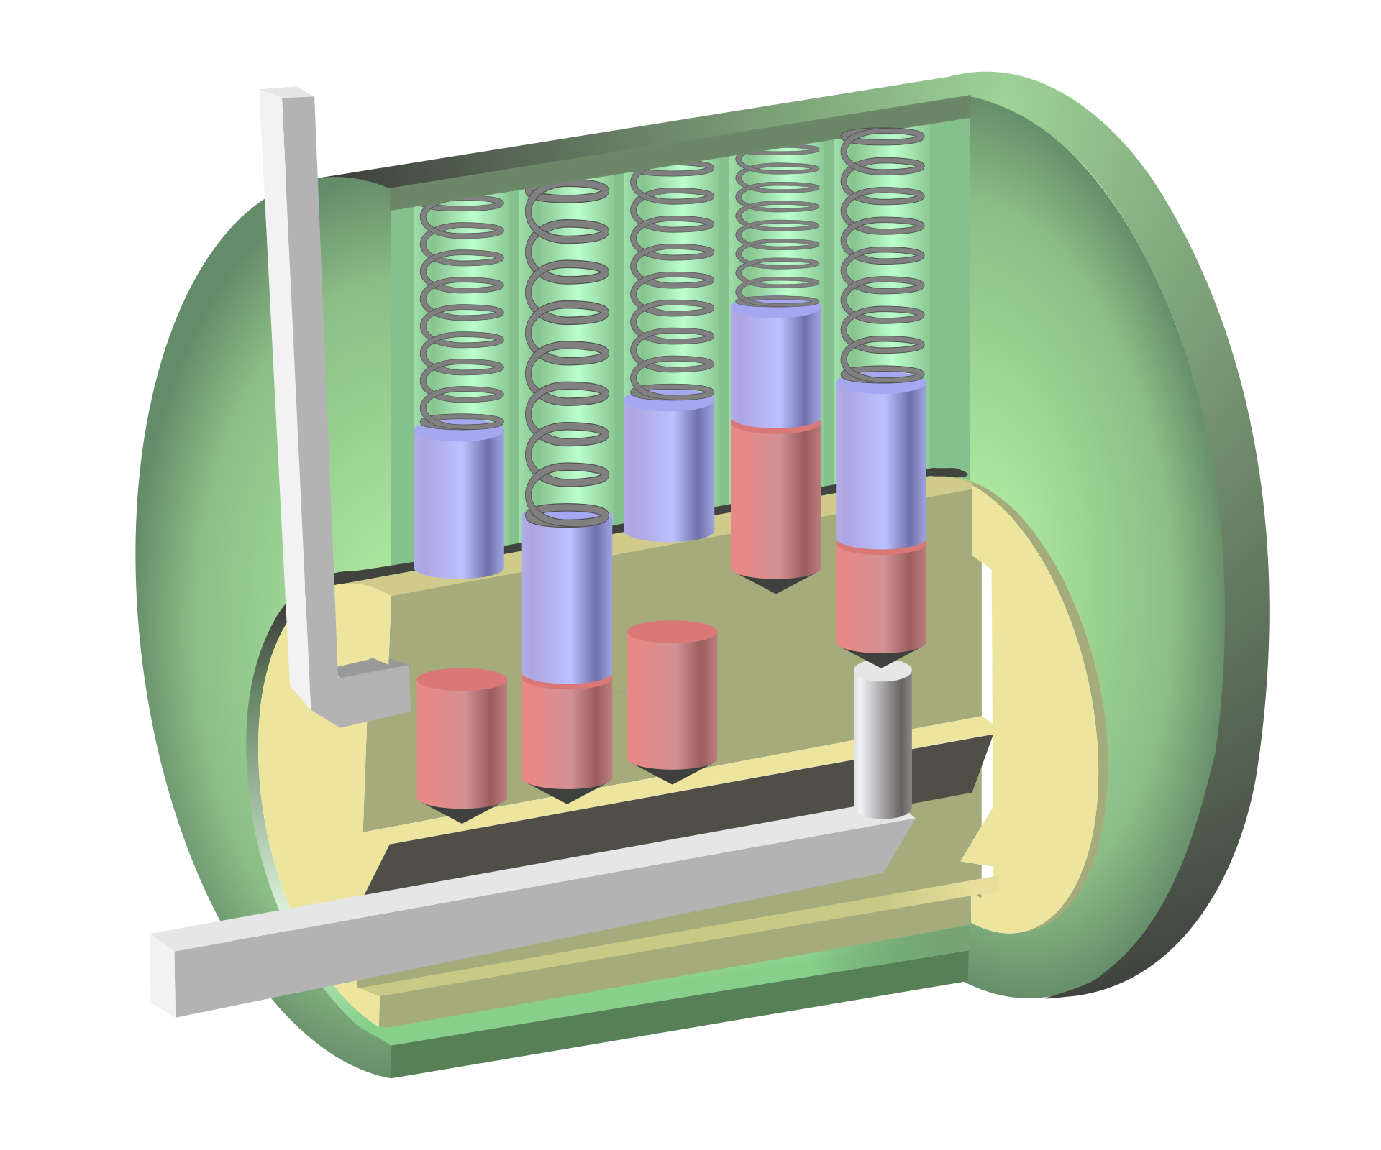
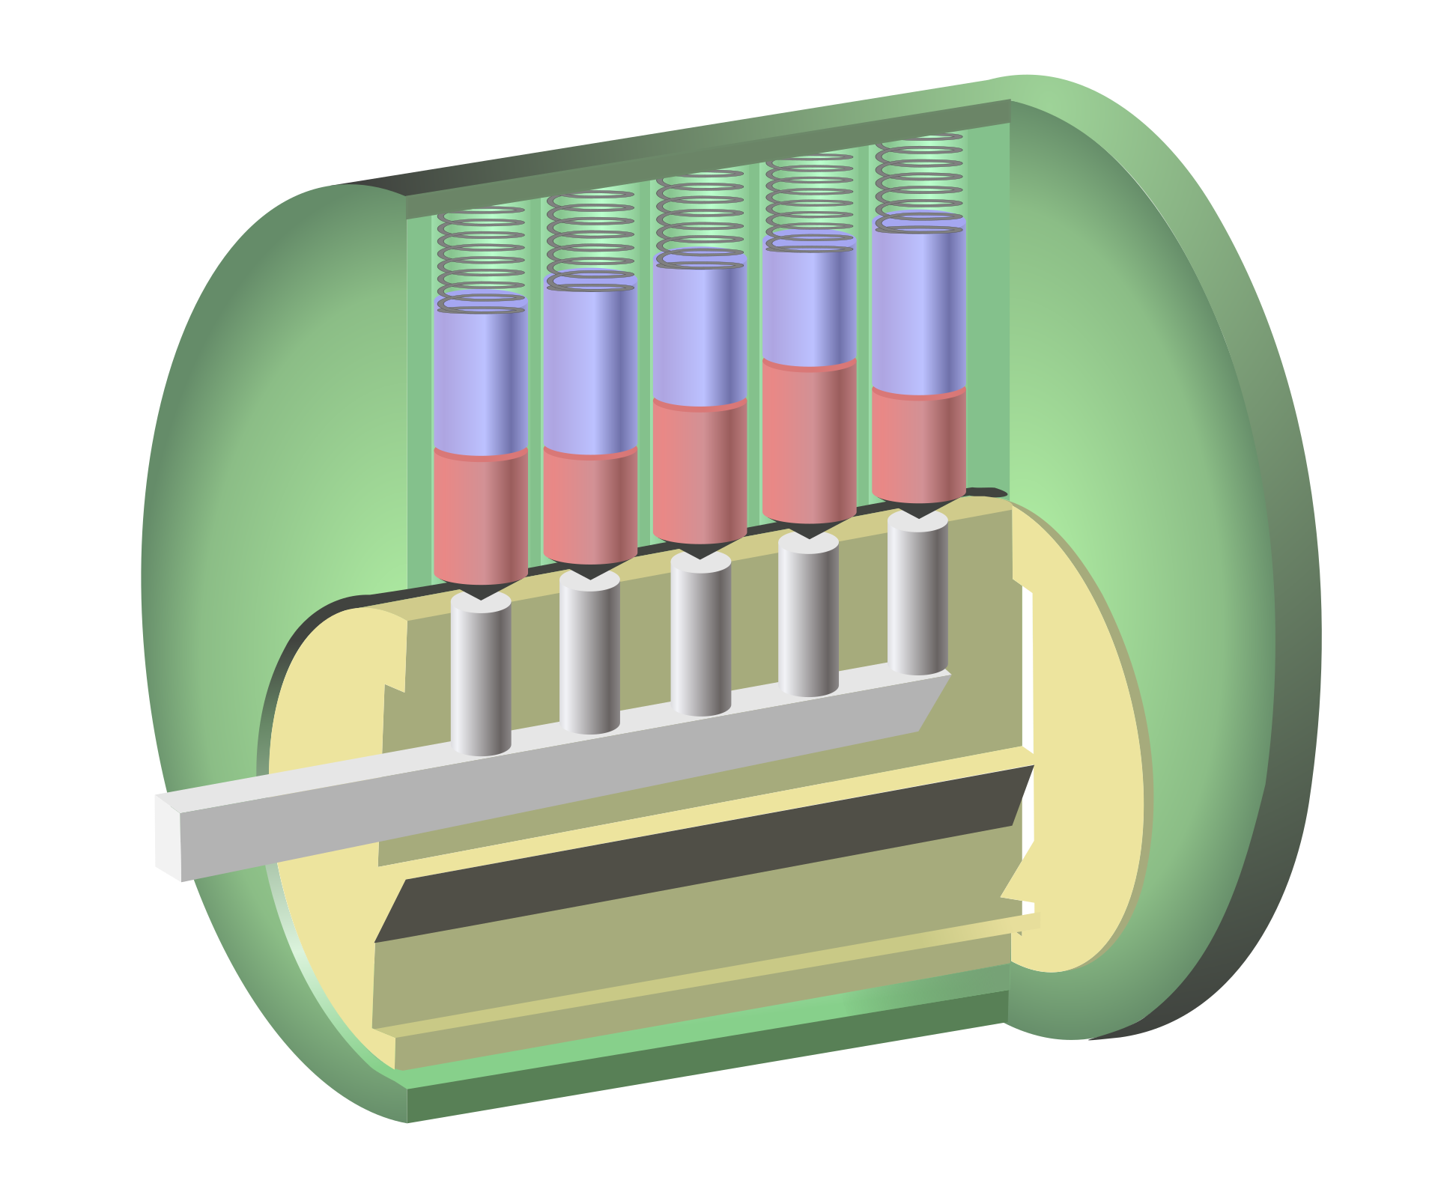
Lock Picking
Pin Tumbler Locks:
Notes:
Image credit: https://en.wikipedia.org/wiki/Pin_tumbler_lock#Cylinder_locks Image credit: https://en.wikipedia.org/wiki/Lock_picking

Slide 12
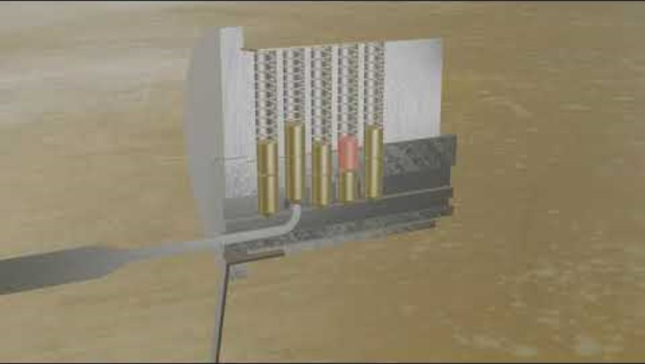
Lock Picking
Pin Tumbler Locks:

Slide 13
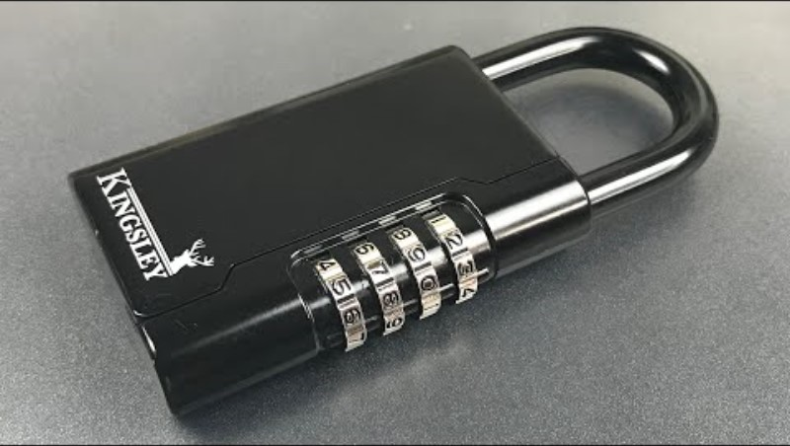
Lock Picking
Combination Locks:

Slide 14

Lock “Picking”
Notes:
Image credit: https://revolar.com/cut-a-lock-with-bolt-cutters/

Slide 15
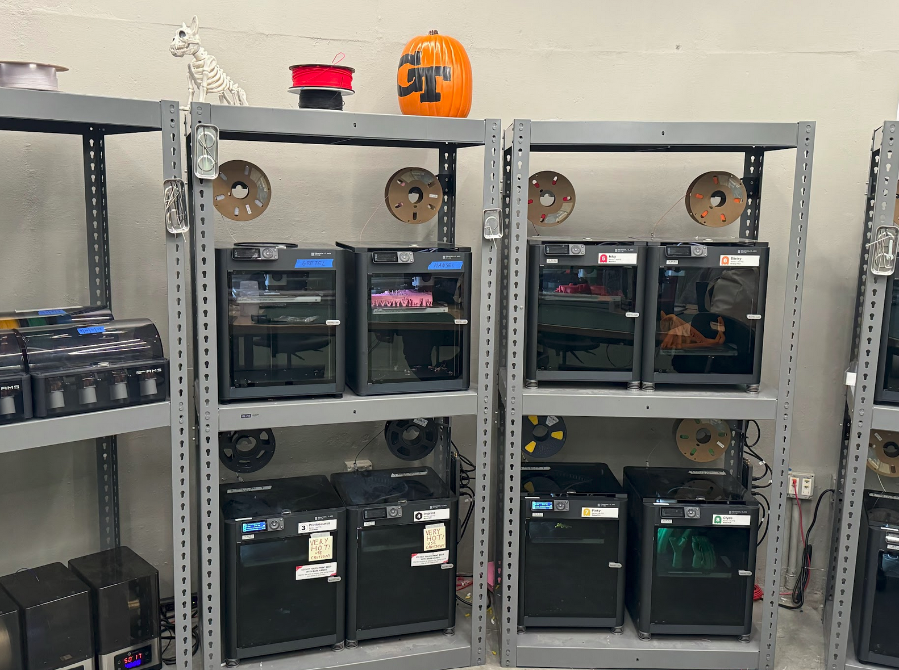
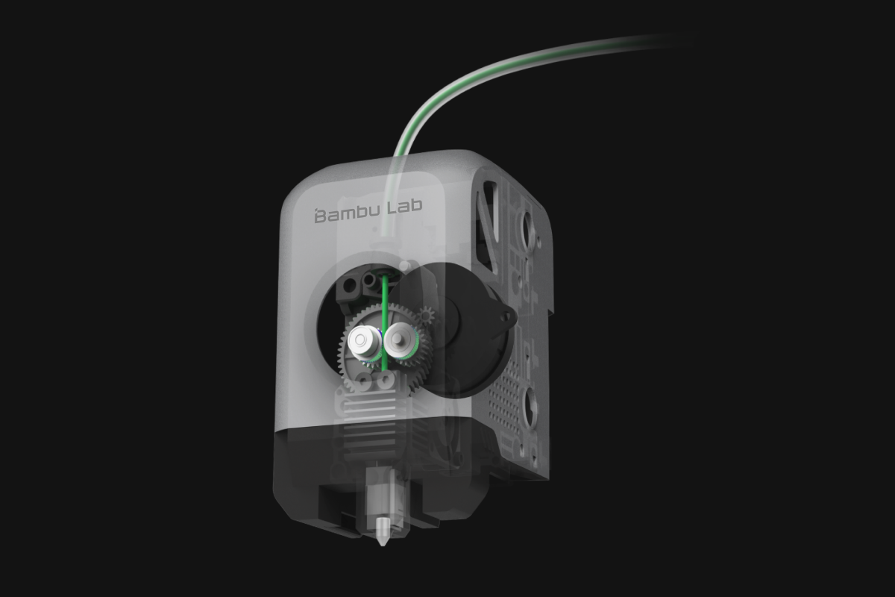
3D Printing
3D Printing, or additive manufacturing, creates objects modeled on a computer, printing the objects layer by layer. Prints can be made out of many different materials, such as ABS, PLA, TPU, and Resin
Notes:
Image credit: https://bambulab.com/en/p1

Slide 16
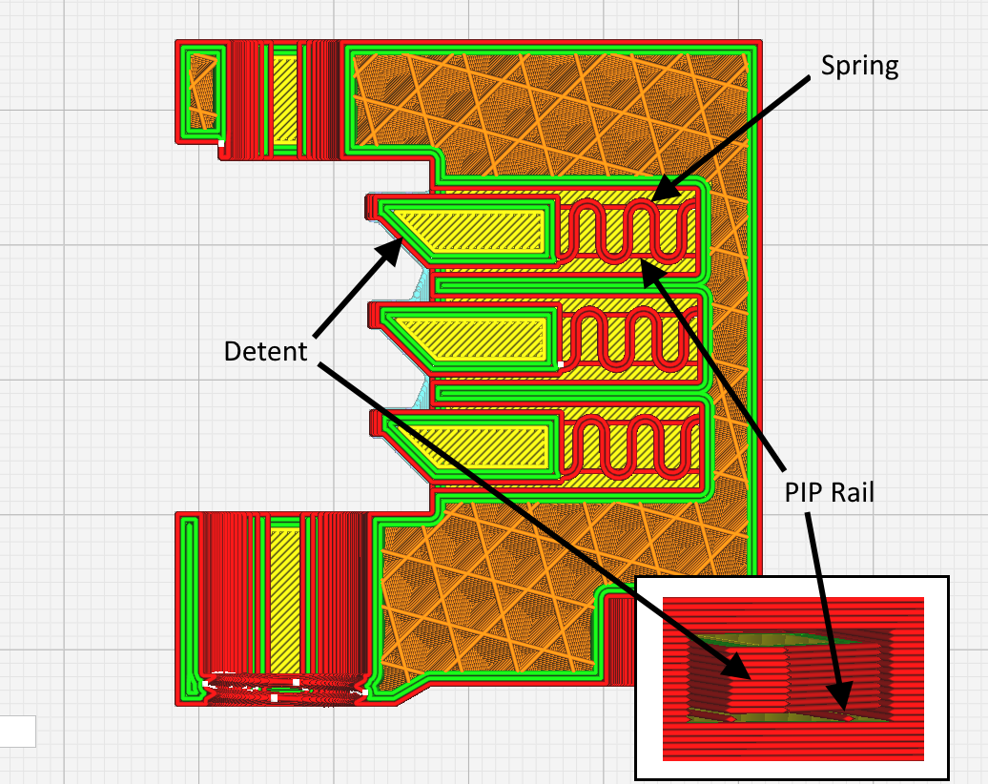
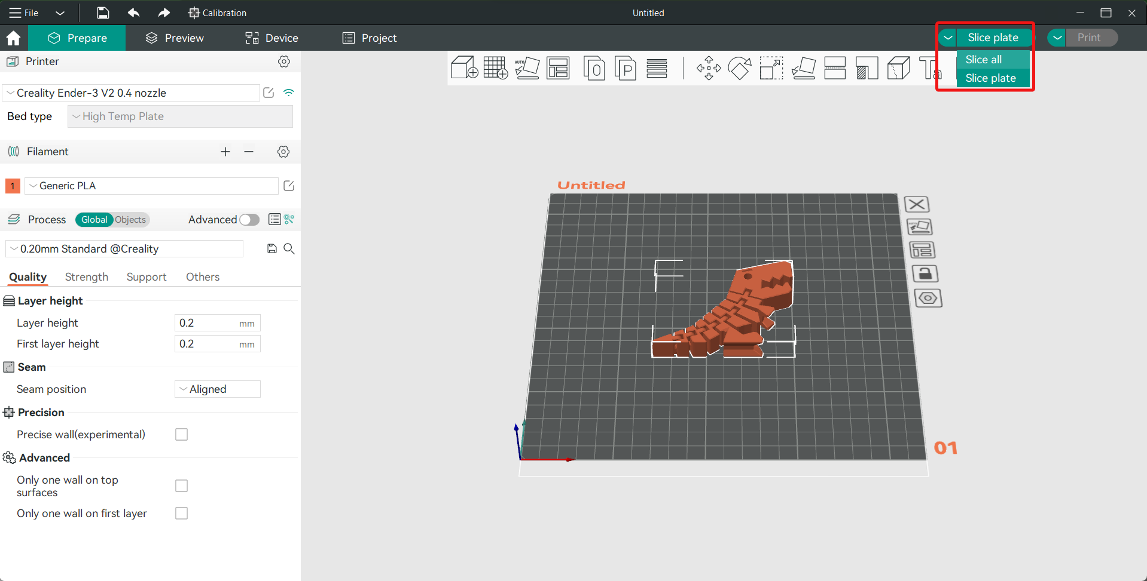
3D Printing
To 3D print, an object must first be modeled with dimensions in modeling software (CAD, Fusion360, OnShape, etc) and be saved as a specific file type. The slicing software will then send the object as layers to the 3D printer so it can read and print the file.
Notes:
Image credit: https://www.obico.io/blog/orcaslicer/

Slide 17
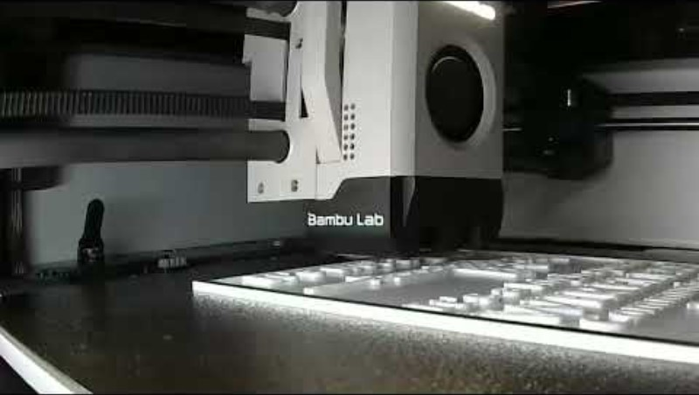
3D Printing

Slide 18

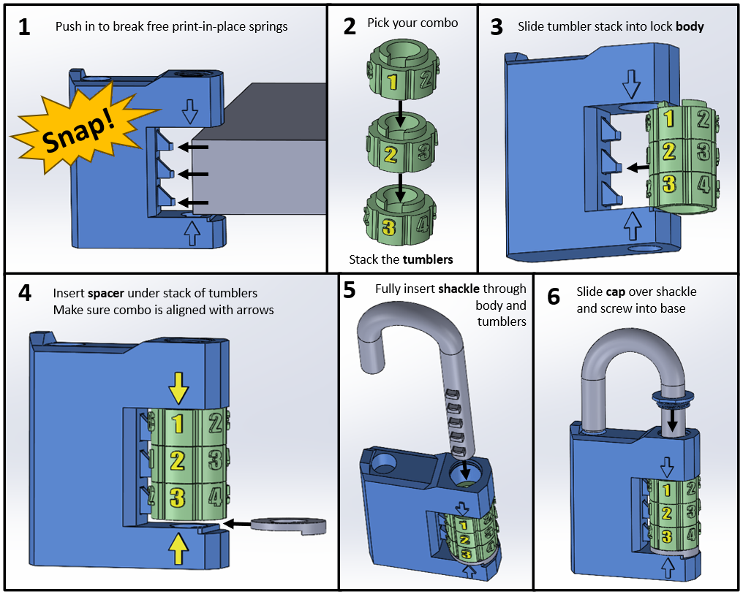
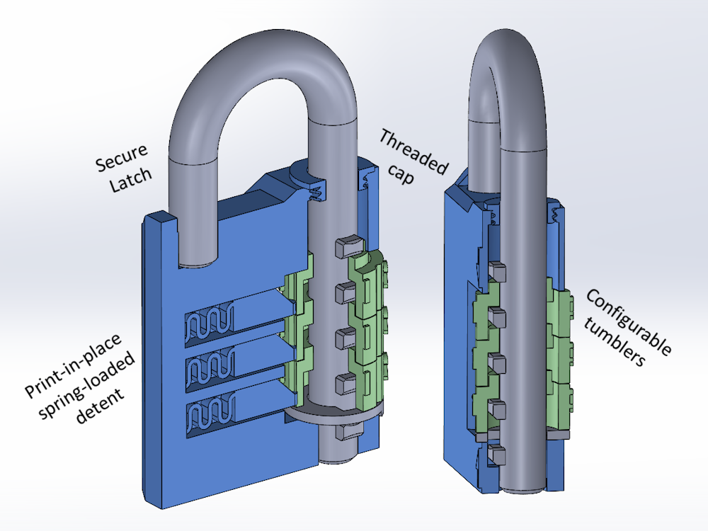

3D Printed Combination Lock Assembly

Slide 19
Thank you!
Note: Do NOT use these locks to function as actual locks, they are made from plastic and will easily break

